Slide 1
Participatory Democracy Practices in Turkey
Citizen Assemblies for a New Constitution
Local Governance Meetings
(İzmir Experience)
participatory democracy in Tury
Brussels, 2013

Slide 2
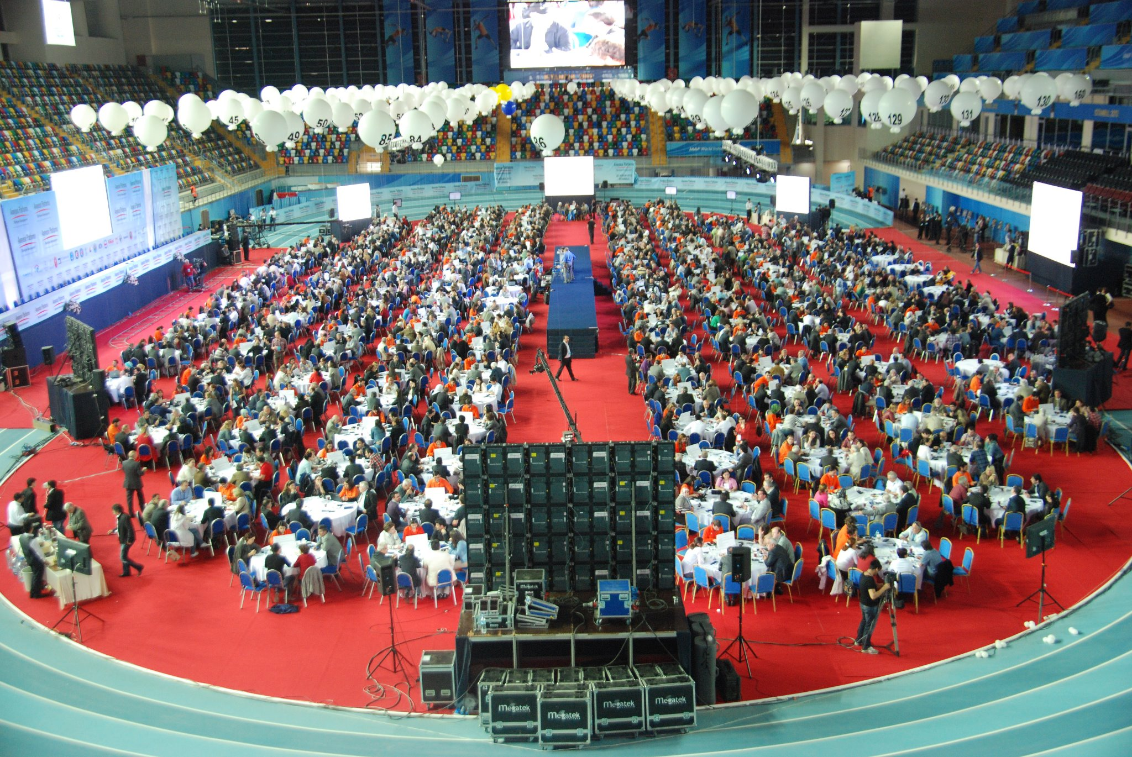
Constitution Platform – Turkey Speaks
Citizen Assemblies for a New Constitution

Slide 3


Slide 4
Outline
Constitution Platform’s achievements
  Constitution making as conflict resolution
  Novelty of today’s constitution making
  Our method: Turkey Speaks, but how?
  Our achievements
Constitution Volunteers’ expectations
  Who are they?
  Demand for a brand new constitution
  5 important questions
  The persistent demand for justice
Turkey’s most pressing problems
  Bringing back the European perspective
Conclusion

Slide 5
Constitution making as a conflict resolution device?
We asked a question to consider.
  Do the needs and dynamics of constitution making and conflict resolution overlap in Turkey?
The transitional significance of the constitution-making process for Turkey
  Ballot-box democracy had already consolidated.
  Through constitutional dialogue, ballot-box democracy was reinforced with a notion of rights-based, pluralist democracy.
    This is where CP came as a best practice.

Slide 6
What was new about the constitution making process?
A parliamentary Conciliation Commission
  Equal representation of all parties
  Unanimity sought in decision making
    Deliberation in the table and in all conflictive areas.
Constitution Platform Citizen Assemblies
  First participatory and deliberative democracy experiment
  Voluntary participation in constitution making
Diversity in participation
  Heterogeneous groups showing the capability to discuss, if not totally resolve, polarizing issues

Slide 7
TGNA schedule
31 December 2011
  Submission of written proposals
30 April 2012
  Finalization of participatory contributions, data compilation and evaluation (CP’S CITIZEN ASSEMBLIES)
May 2012-September 2012
  Determining the constitional principles and writing the draft with the unanimous consent of all parties
    Not cover to cover, but article by article (non-numbered articles)
    Ordering the articles.
September 2012-December 2013
Conciliation Commission reviews the draft and puts it forward as a proposal to be debated in the plenary session of the Grand National Assembly.
A package covering 60 articles is been discussing to be debated in the plenary session of the Grand National Assembly.

Slide 8
Constitution Platform (CP)
Turkey Speaks
An initiative led by the Turkey side of the Turkey-EU Joint Consultative Committee
  Bringing together more than 20 NGOs under the motto Turkey Speaks
A daring objective:
  Organizing Citizen Assemblies under TEPAV’s secretariat
  Demonstrating how a culture of consensual dialogue can deal with contentious issues
  Taking the constitutional debate one step further:
    From constitutional principles to concrete constitutional expectations
Constitutional Conciliation Commission of the Turkish Grand National Assembly (TGNA) supported the process.
  Speaker of Parliament and commission members from each political party attended every single Citizen Assembly.

Slide 9
The process of organization

Slide 10



Reaching out to the people
2 ways of asking the people to become
“Constitution Volunteers”
1
2
2/3 of participants
Citizens who answered the randomly sent messages through cell phones
1/3 of participants
Local NGO representatives invited by going through every available list
Mobile phones; effective and legitimate
  Turkish people’s use of mobile phones above the European average
  62 million cell phone subscriptions
  A monthly average of 90 min. talk per person
3
Size of available halls determined the number of participants

Slide 11
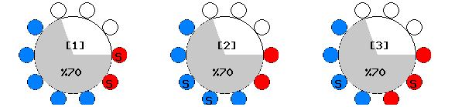
Ensuring diverse tables
A special software designed by TEPAV to make sure that
  each table has at least 6 participants
  each table has at least 2 woman participants
  each table has at least 2 local NGO representatives plus
  2 citizens randomly invited through cell phones
  no table has participants with the same surname
  no table has participants from the same local NGO

Slide 12

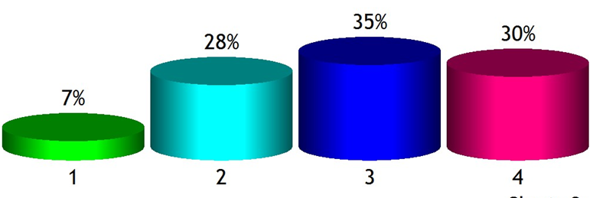
Our method (1)
Turkey Speaks, but how?
First deliberative democracy experience in the history of Turkey
~ 50 QUESTIONS
~ 10 HOURS OF DEBATE
DELIBERATION
POLLING
Instant documentation of discussions
Instant display of the results of decisions
PARLIAMENT’S
CONSTITUTIONAL CONCILIATION COMMISSION

Slide 13
Our method (2)
Turkey Speaks, but how?
~ 50 questions designed using a concise and politically enabling language
  A universal, unimposing, non-polarizing vocabulary
    Avoiding the jargon that triggers ossified positions
  Participants encouraged to find their own concepts and keywords
  Questions reviewed in meetings with stakeholders
    A comprehensive list of constitutional issues that matter most for not only institutional design, but also citizens’ everyday lives

Slide 14
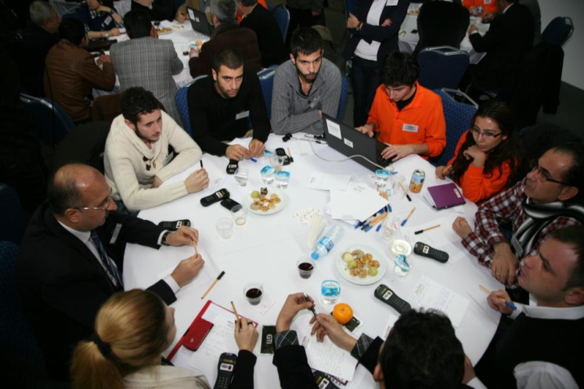
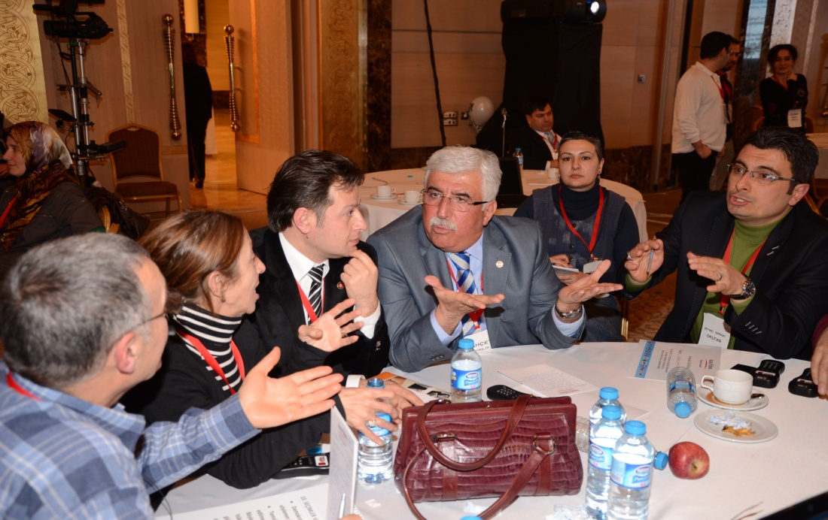
What CP achieved (1)
Our method worked smoothly
Random invitation through cell phones helped us reach heterogenous groups
Carefully designed set of questions encouraged participants to formulate their own demands

Slide 15
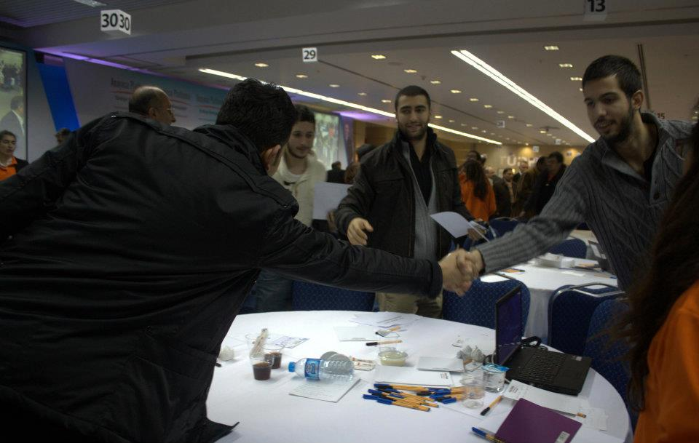
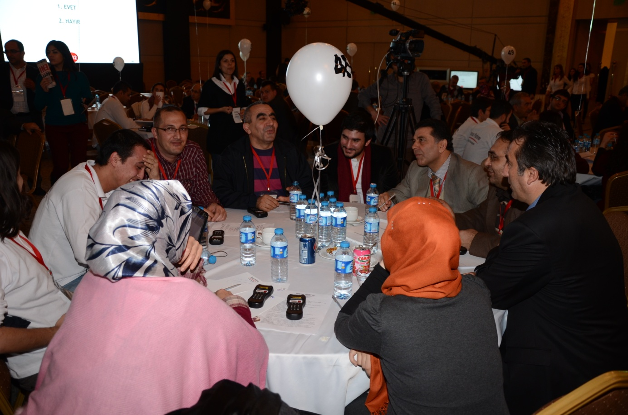
What CP achieved (2)
The possibility of a new approach
Citizen Assemblies showed that every social issue in Turkey could be dealt with from the perspective of deliberative democracy
  Mature and reasonable participants
  Fruitful and civilized discussions

Slide 16
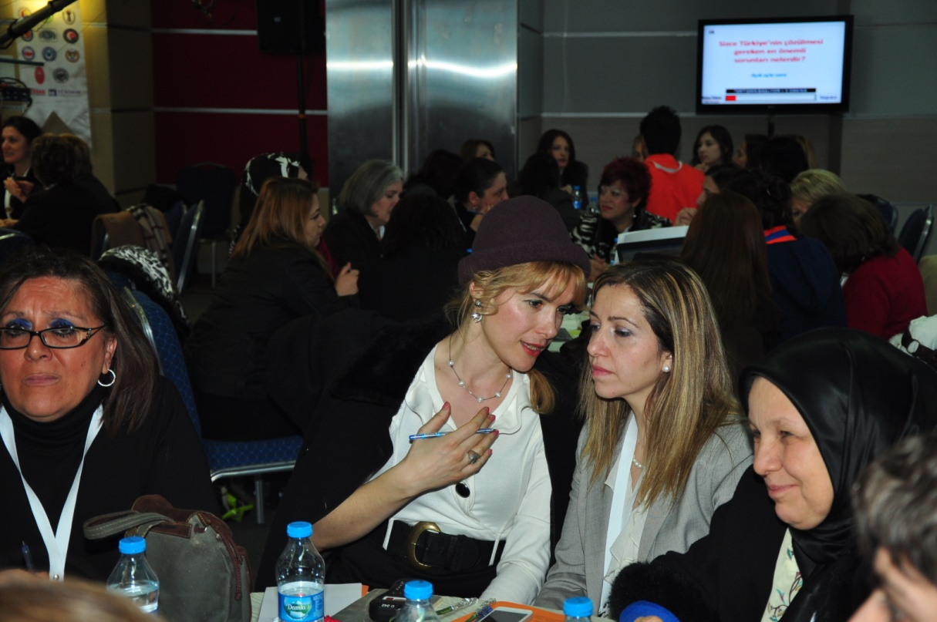
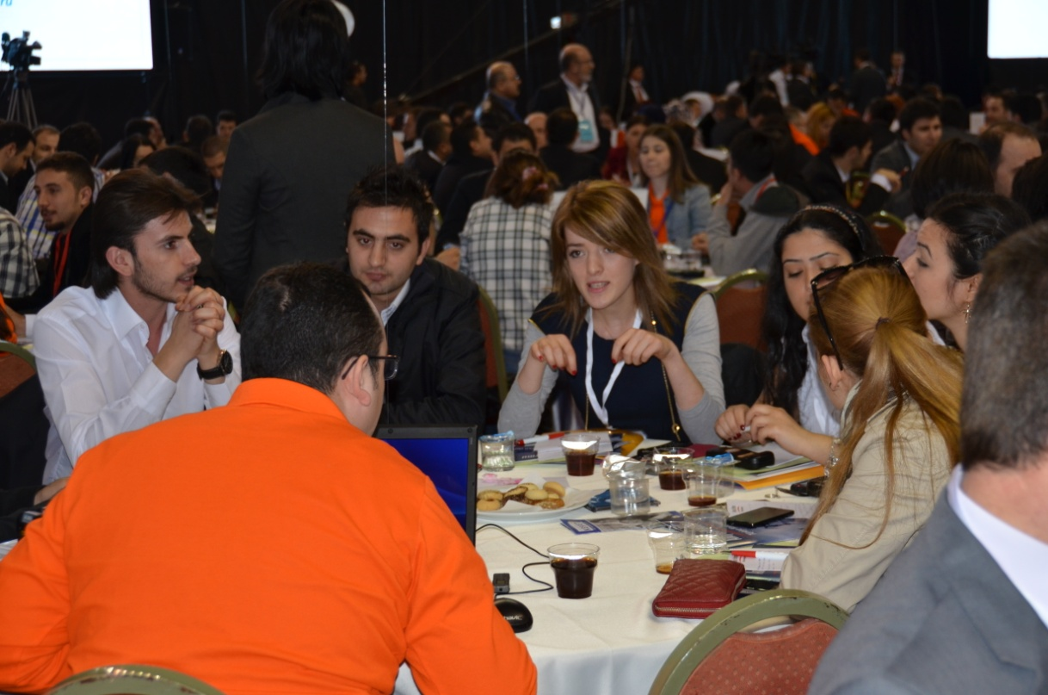
What CP achieved (3)
Empowering women and youth
Targeted events in response to low women and youth participation:
  ~400 women participants /
  8 March Ankara Assembly
  ~350 young participants /
  25 March Samsun Assembly

Slide 17
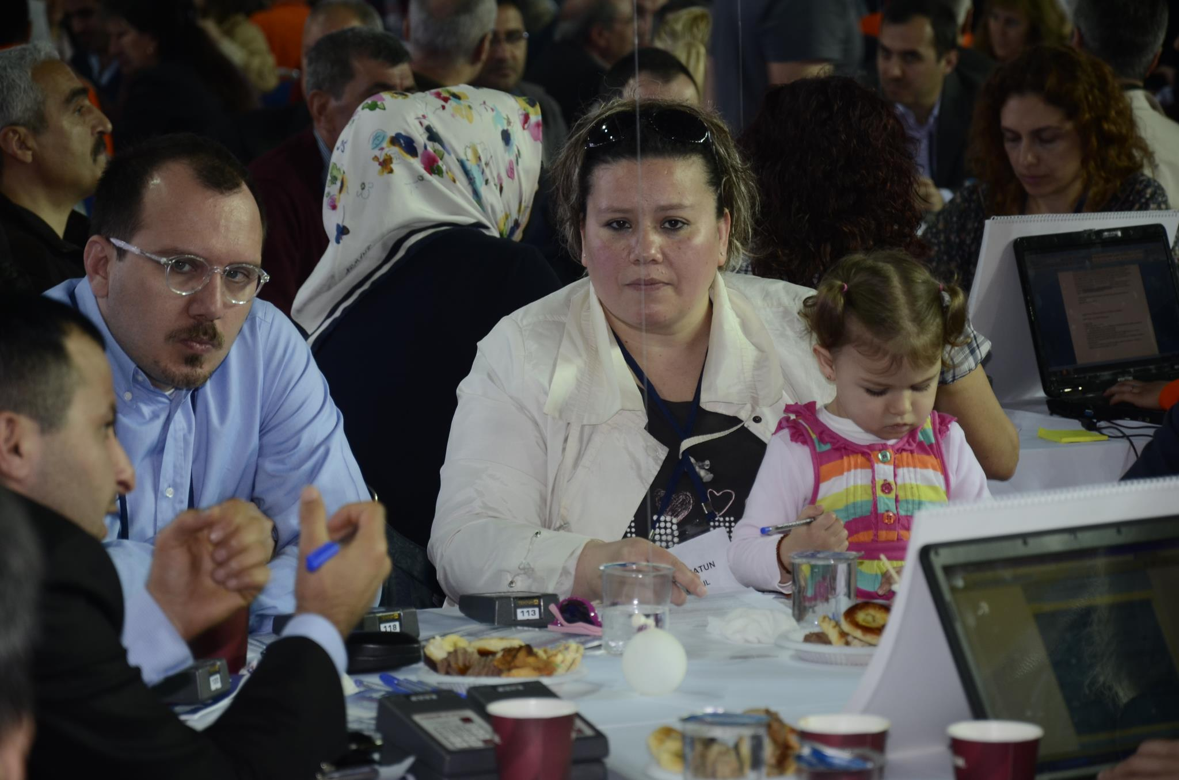
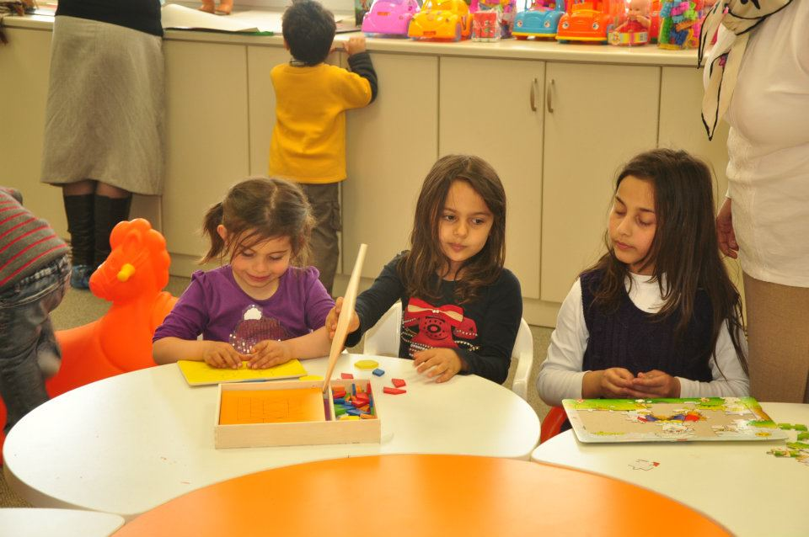
What CP achieved (4)
Trying hard to overcome gender inequality
More efforts to encourage women’s participation
  Child care centers
  Quotas for woman representatives of CSOs
  Call Center’s prioritized calls
  A woman’s voice message randomly invited woman citizens

Slide 18
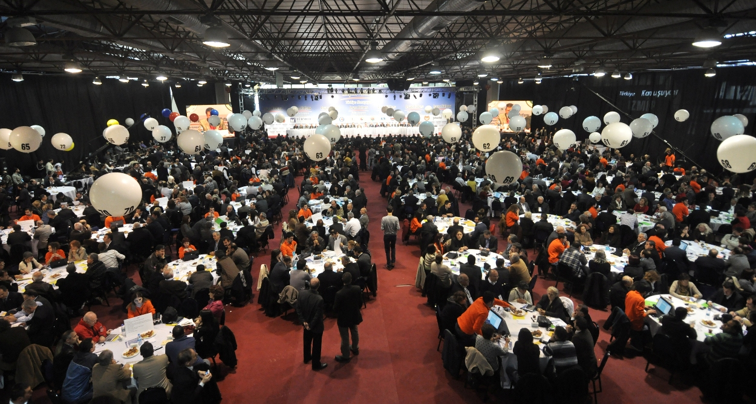
What CP achieved (5)
Engaging the people
A highly influential “constitutional awareness” campaign was successfully carried out.

Slide 19
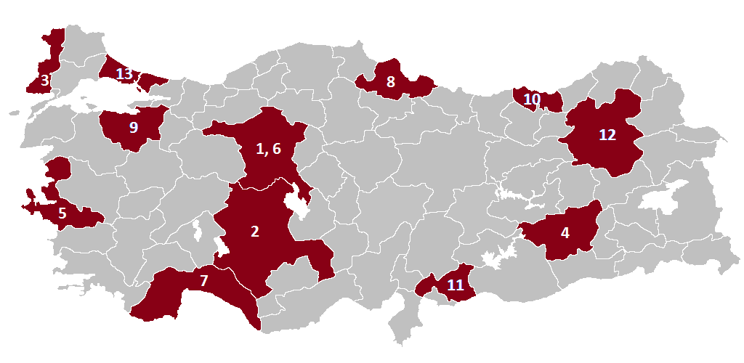
What CP achieved (6)
13 Citizen Assemblies
Citizens’ opinions on constitutional issues compiled in 12 different provinces over a period of 5 months
1,000 discussion tables where groups of 6 to 10 deliberated
~ 15,000 pages of citizens’ opinions compiled

Slide 20
    ~ 6,500 Constitution Volunteers
    A demographically, geographically and professionally diverse sample
Those interested
in constitutional issues participated

Slide 21
Constitution Volunteers
Mainly male, middle-aged, well-educated
AVERAGE OF 13 CITIZEN ASSEMBLIES
AGE
SEX
EDUCATION
Below 30
31-45
Primary School
Secondary
FEMALE
FEMALE
High School
Undergrad
Above 61
MALE
46-60
Postgrad

Slide 22
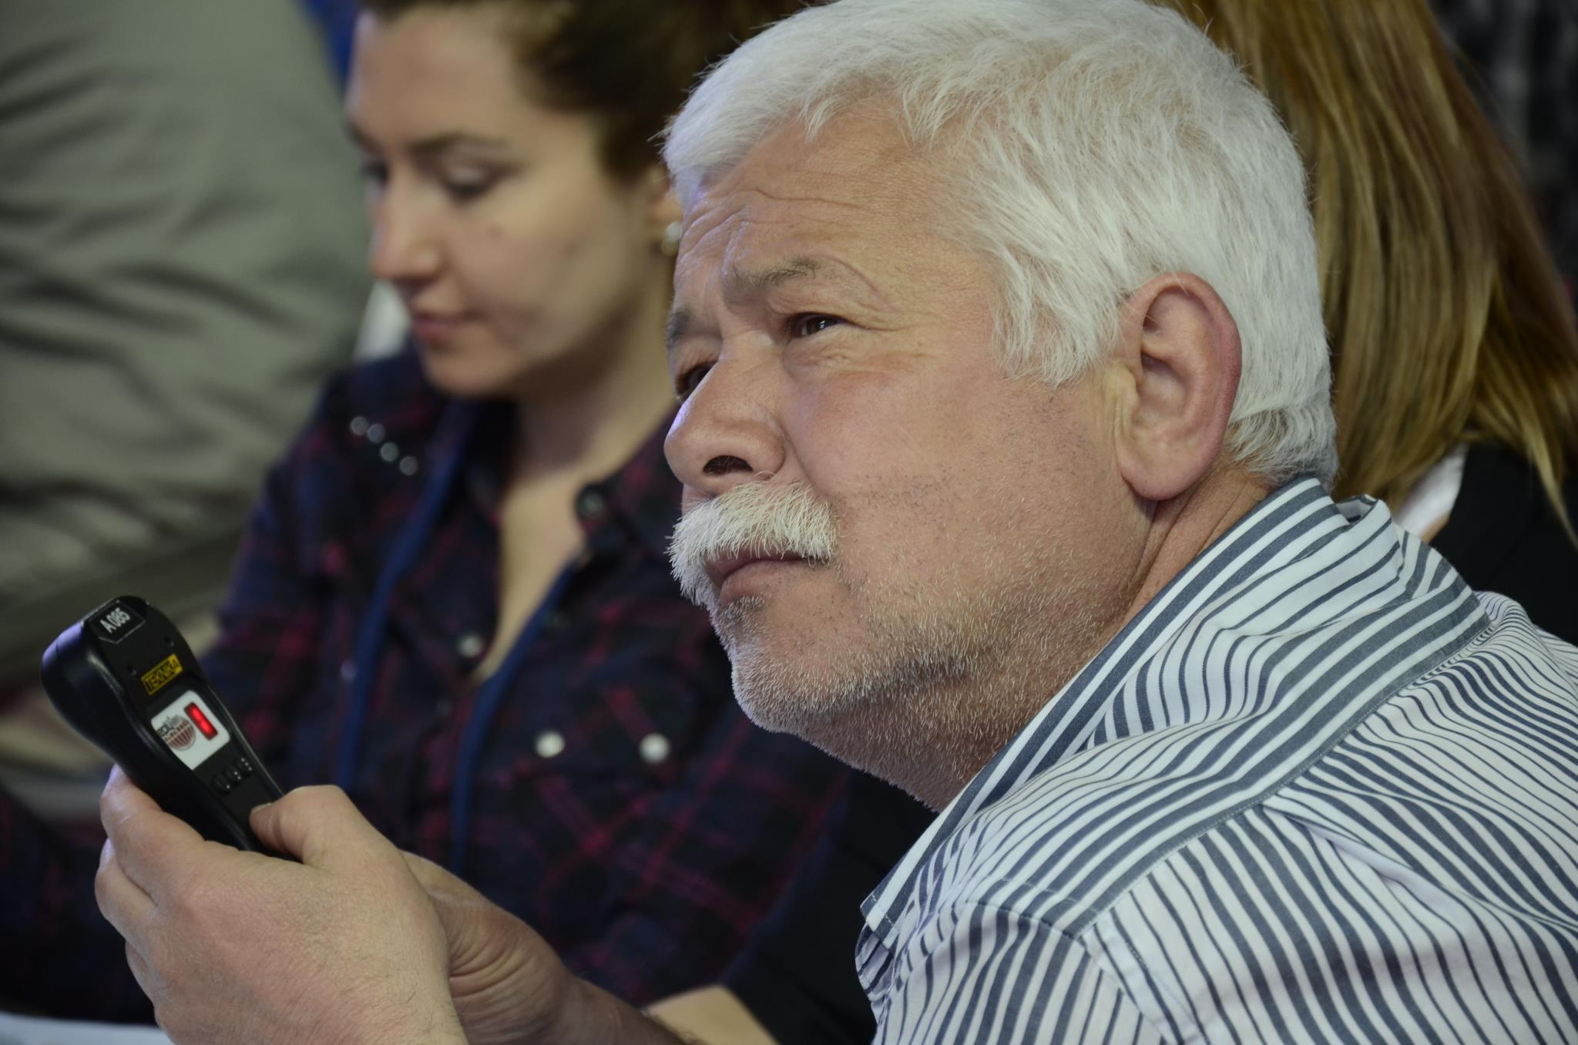
What do you think of the current constitution?
Do you like it?
Does it need to change?

Slide 23
75% of participants don’t like the current constitution for several reasons
AVERAGE OF 13 ASSEMBLIES
I DON’T LIKE IT
I LIKE IT

Slide 24
Among those who don’t like the current constitution, majority demands a brand new constitution
AVERAGE OF 13 ASSEMBLIES
I DON’T LIKE THE CURRENT CONSTITUTION AND…
Some articles need to change
A completely new constitution must be made
A completely new constitution must be made, but time is not right

Slide 25

5 important constitutional issues
Cohabitation of divergent groups within the society
Public services
Local governance
Governmental systems
Judicial independence and the rule of law

Slide 26
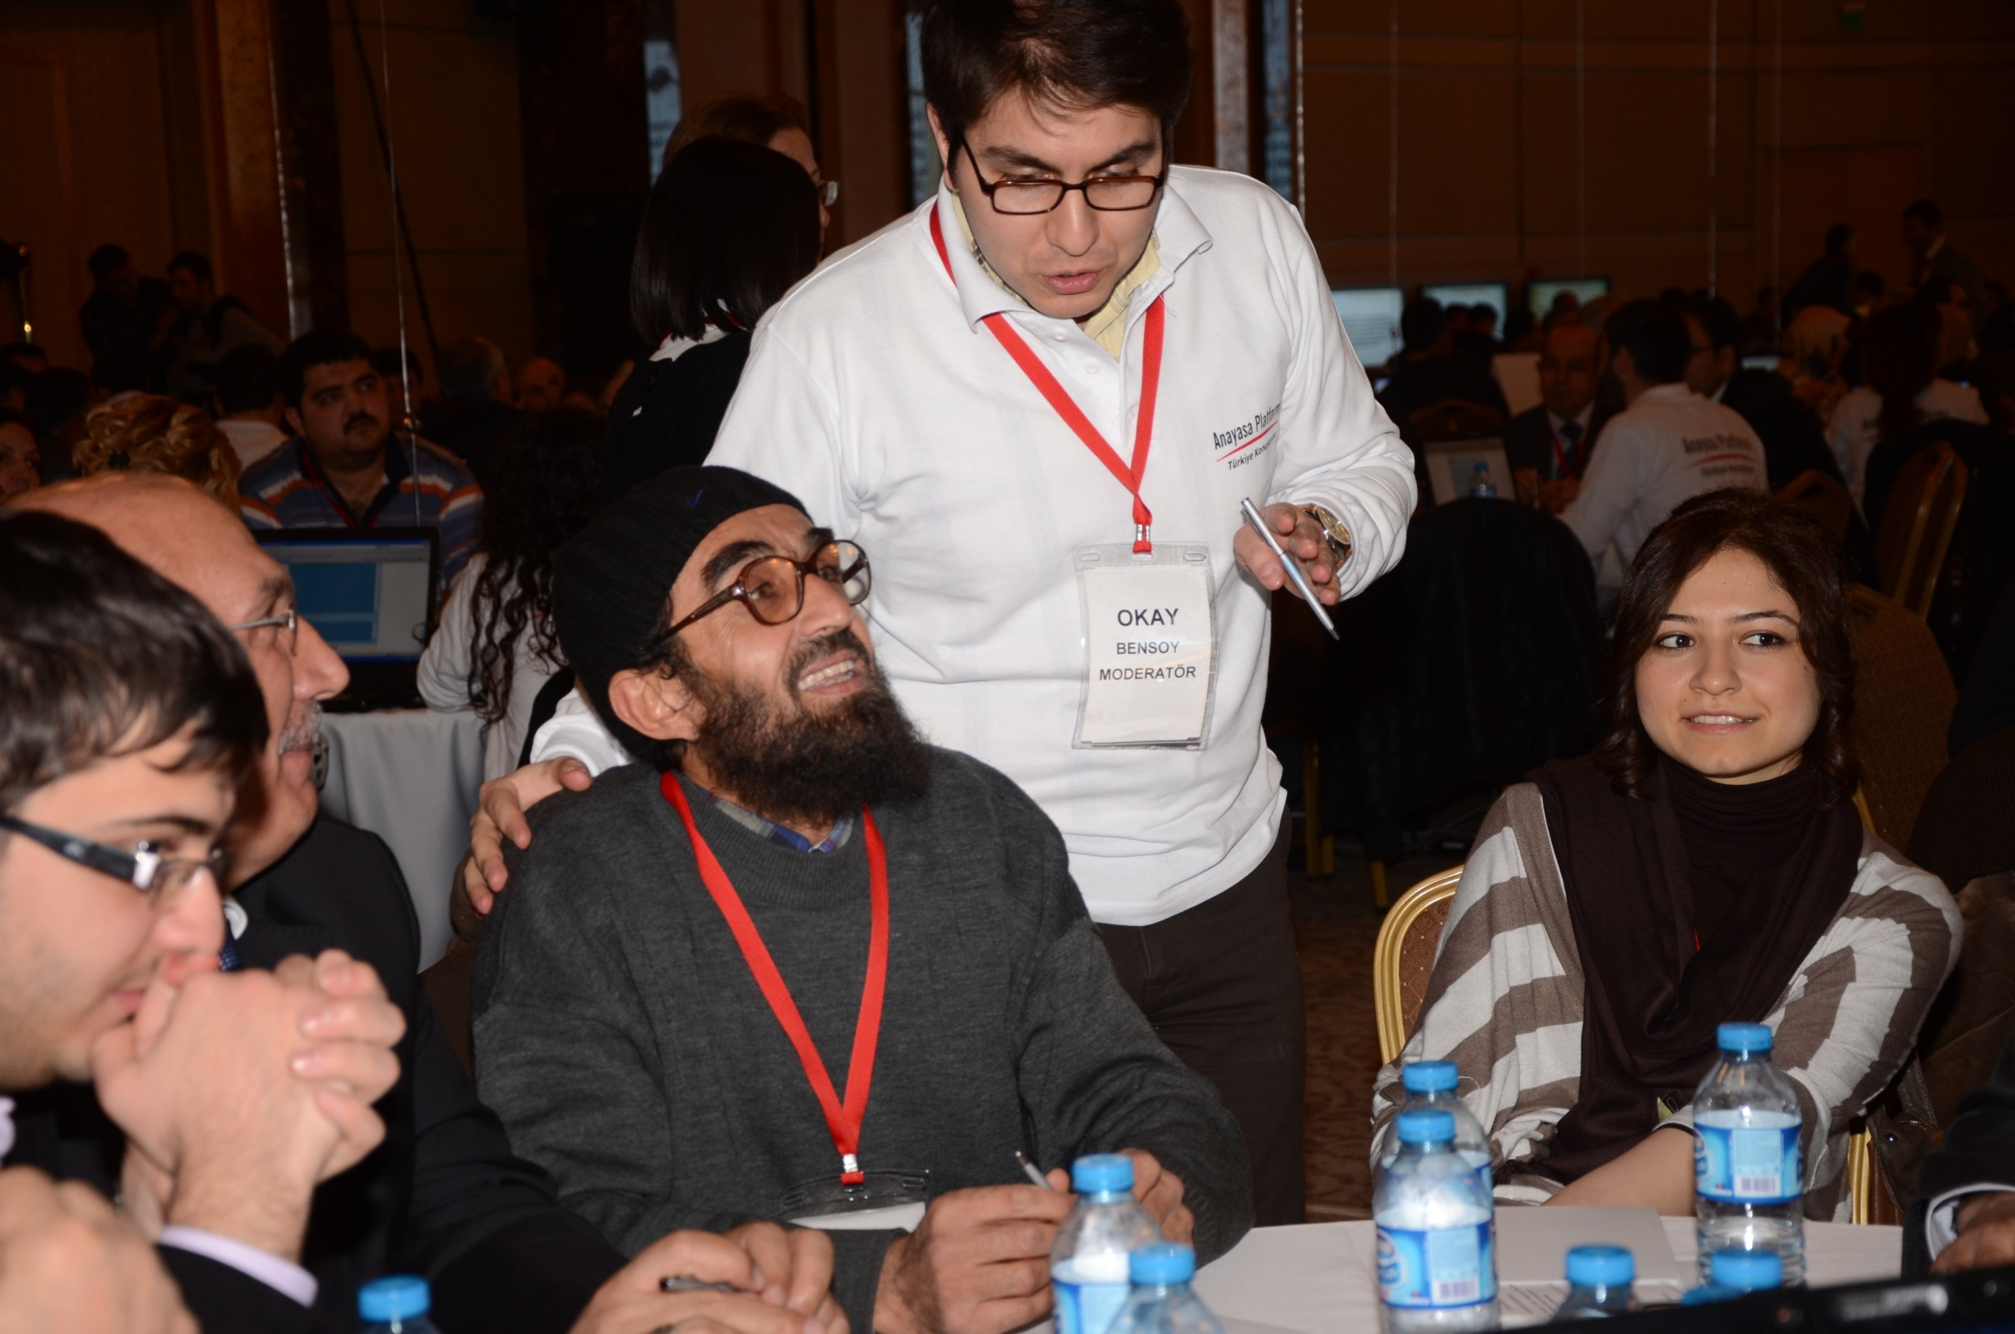
Cohabitation of divergent groups within the society

Slide 27
PROHIBITION OF DISCRIMINATION
CONSTITUTIONAL PRINCIPLE
Everyone should be protected against discrimination regardless of their differences
Should the new constitution contain an explicit clause banning discrimination against persons and groups of different orientations, preferences and origins?
QUESTION
COHABITATION
CONSTITUTIONAL PRINCIPLE
All are equal before the law and are entitled without any discrimination to equal protection of the law. (UDHR, Art.7)
Do you think that providing persons and groups of different orientations, preferences and origins with constitutional guarantees facilitate the cohabitation of divergent groups within society?
QUESTION

Slide 28
“Who are we?”
A particularly difficult, open-ended question
  Who are we? How do you define the people living in this country?
Participants are more comfortable when answering the question “Who am I?”
  i.e. politicians are yet to summon a sense of “We the people” in the citizenry.

Slide 29
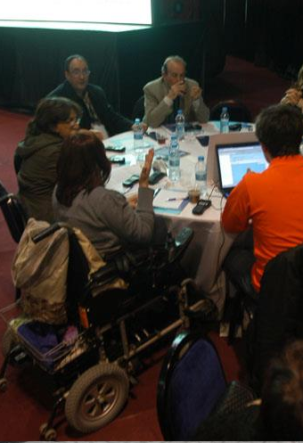
Public services
Equal access
Impartiality

Slide 30
EQUAL ACCESS TO PUBLIC SERVICES
CONSTITUTIONAL PRINCIPLE
The state has a duty to ensure that citizens are capable of using their basic right to equal and effective access to public services.
Should there be additional regulations in the new constitution that take note of citizens’ differences in order to ensure that all citizens have equal and effective access to public services?
QUESTION
IMPARTIALITY OF PUBLIC SERVANTS
CONSTITUTIONAL PRINCIPLE
When providing public services, the state has an obligation to behave in accordance with the principle of impartiality .
Do the differences in the dressing and appearances of public servants reflecting their way of life and thinking harm the principle of public service impartiality?
QUESTION

Slide 31
Perceptions of
“equal access to public services”
How are “differences” perceived?
  Disabilities, sexual orientations, religious sects, ethnic identities
Opinions regarding the “additional regulations that take note of citizens’ differences”:
  Equal access to religious services (Ankara)
  Lifting the ban on headscarves (Konya)
  Affirmative action for the Roma people (Edirne)
  Provision of services in Kurdish (Diyarbakır)
  Enabling the participation of disabled persons in social life (İzmir)
  Yes to “equal access”, no to “additional regulations” (Ankara)
Serious debates over the Kurdish issue

Slide 32
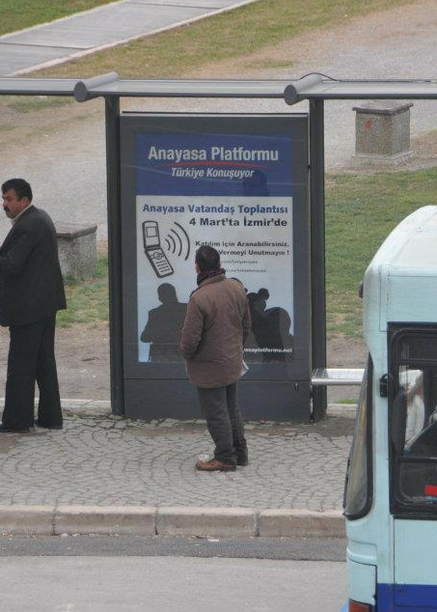
Local Governance

Slide 33
LOCAL GOVERNANCE
CONSTITUTIONAL PRINCIPLE
The principle of subsidiarity serves as the basis according to which the regime of public services is designed and implemented.
QUESTION
Which level of administration, central or local, do you prefer in terms of decision making with respect to public services and the city you live in?
Do you think that empowering local administrations, that is, enabling their role in decision-making processes, can help solving Turkey’s problems?
QUESTION

Slide 34
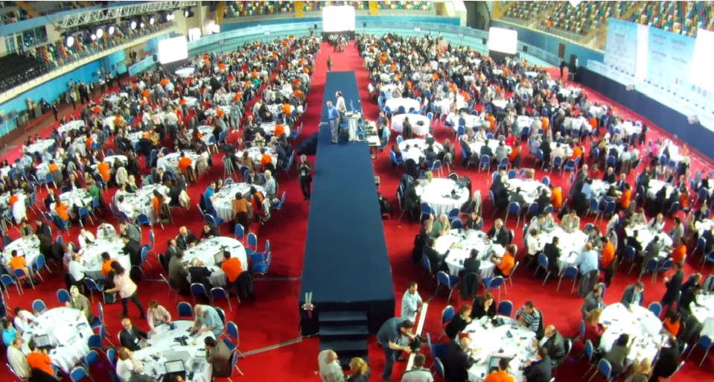
Governmental Systems

Slide 35
GOVERNMENTAL SYSTEMS
CONSTITUTIONAL PRINCIPLE
Power sharing between the president and government is designed with reference to the principles of political stability and effectiveness
QUESTION
How should the status of the President of the Republic be defined in the new constitution?
QUESTION
How should the executive be designed in the new constitution?

Slide 36
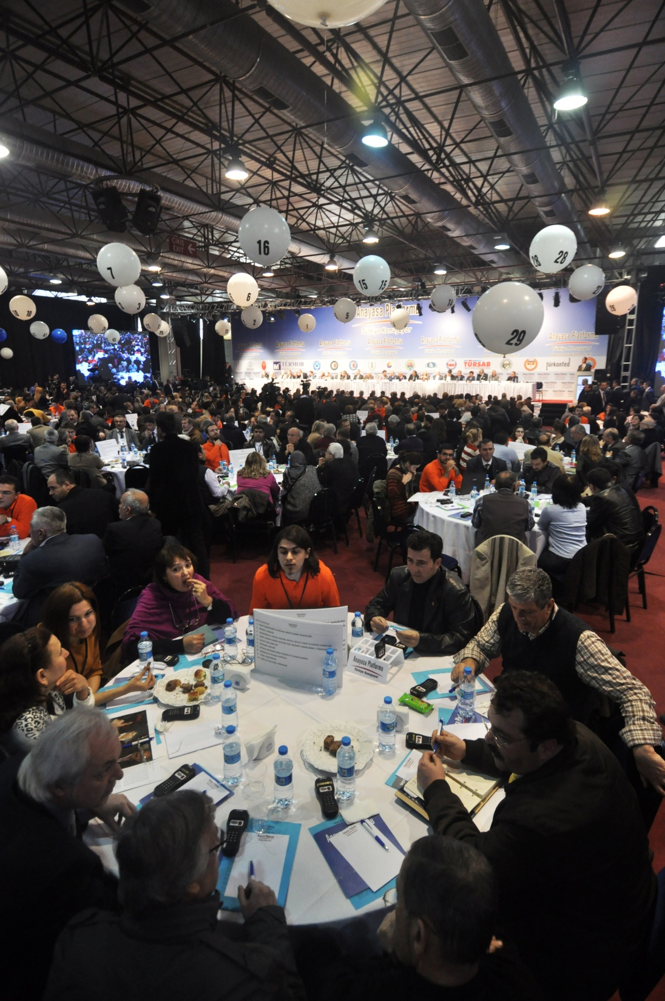
Judicial independence and the rule of law

Slide 37
JUDICIAL INDEPENDENCE
CONSTITUTIONAL PRINCIPLE
Measures are taken in the light of universal standards so that the judiciary does not receive any advice, suggestion, instruction or direction from any organ, office, authority or person and is not under the influence or control of such parties.
Should the new constitution make new regulations aimed at lessening the impact of the executive on the recruitment, admission, appointment and promotion of judges and their disciplinary and personnel issues and on bodies regulating these areas in order to strengthen judicial independence?
QUESTION
ACCOUNTABILITY
CONSTITUTIONAL PRINCIPLE
Effective mechanisms ensuring that administrators are accountable to law should be designed.
QUESTION
Should there be more effective mechanisms in the new constitution ensuring that administrators are more accontable for their actions?

Slide 38
RULE OF LAW
CONSTITUTIONAL PRINCIPLE
Judicial immunities of public servants are restricted to the requirements of public service.
Should the new constitution include a regulation regarding the topic below in order to strengthen the principle of “rule of law”? More effective judicial review of public servants in the new constitution.
QUESTION
The scope of parliamentary immunities should be restricted to ensuring that members of parliament are not hindered in carrying out their legislative functions.
CONSTITUTIONAL PRINCIPLE
Should the new constitution include a regulation regarding the topic below in order to strengthen the principle of “rule of law”? Limiting the scope of the parliamentary immunities of Members of Parliament.
QUESTION

Slide 39
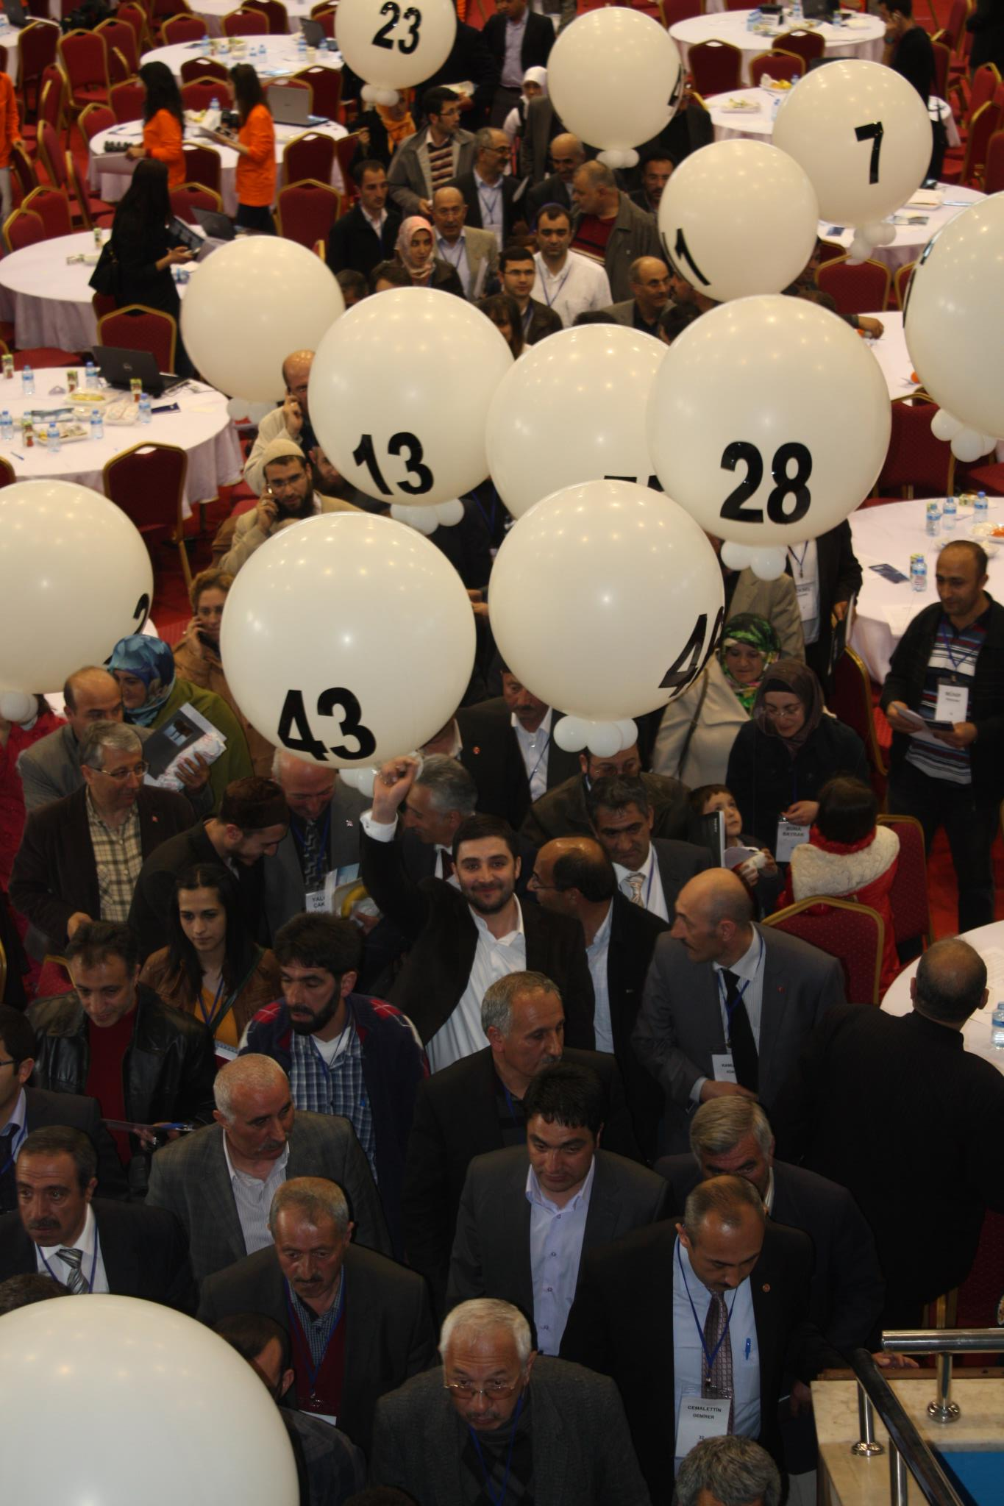
Which principle should be upheld as a priority in the making of the new constitution?

Slide 40
Which principle should be upheld as a priority in the making of the new constitution?
AVERAGE OF 13 ASSEMBLIES
LIBERTY
EQUALITY
WELFARE
STABILITY
JUSTICE

Slide 41
Which principle should be upheld as a priority in the making of the new constitution?
PROVINCES
Justice
Stability
Welfare
Equality
Liberty

Slide 42
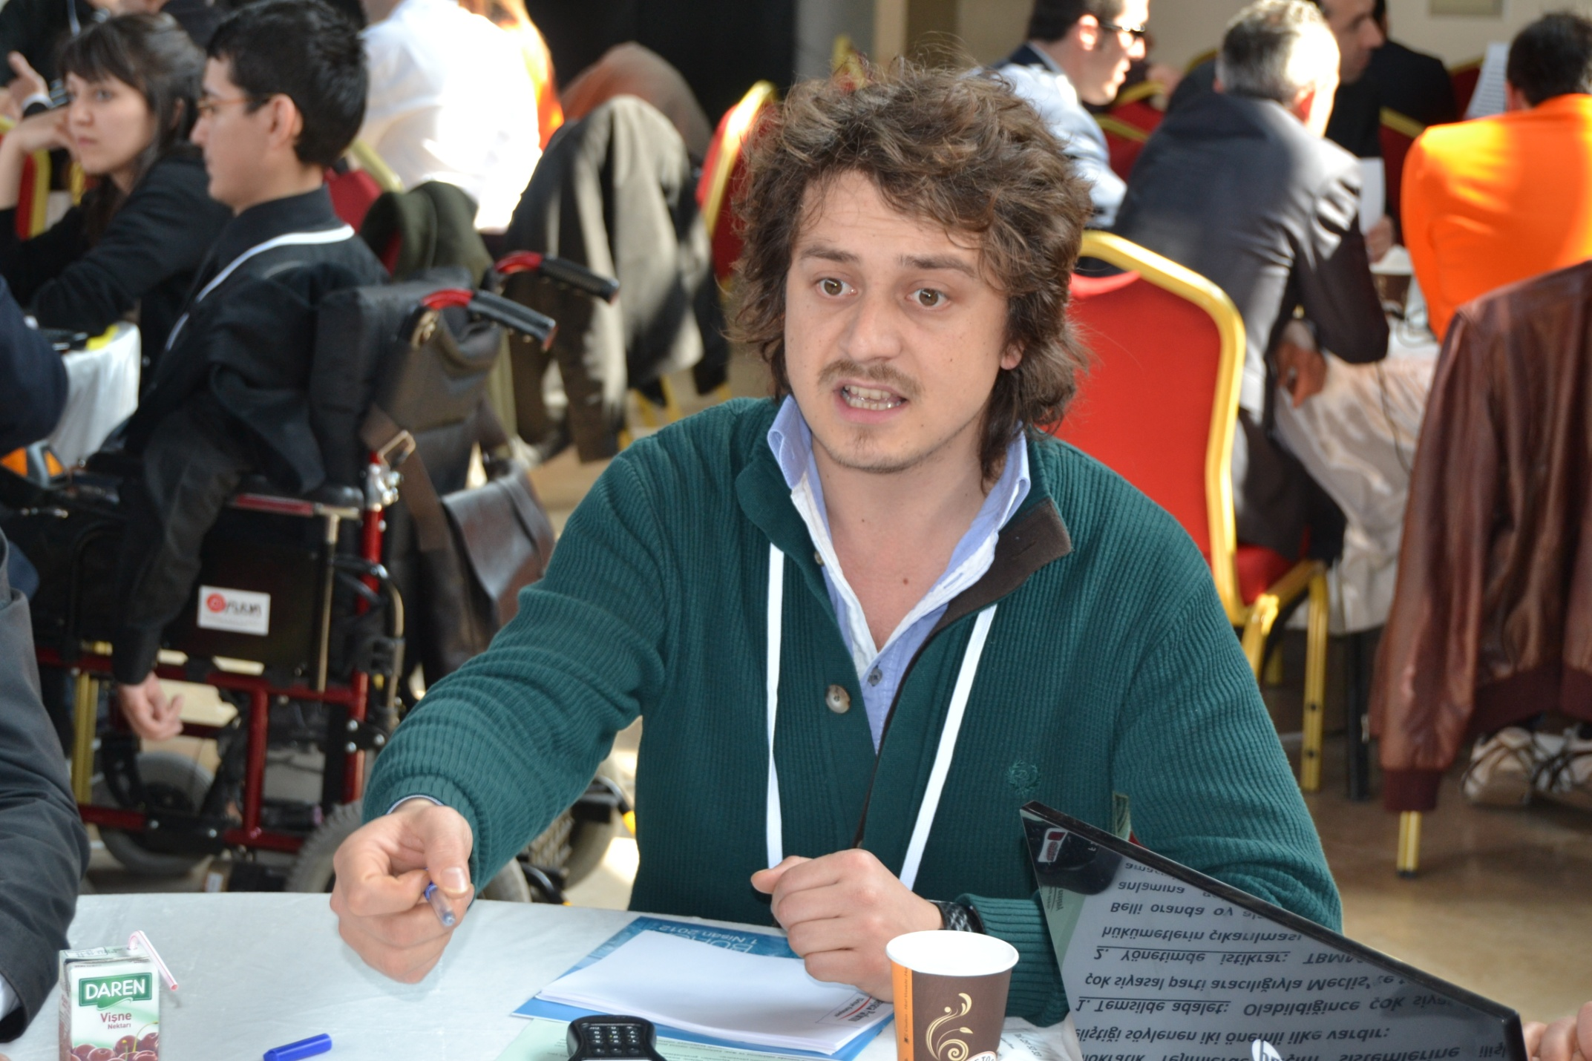
There were intense debates

Slide 43
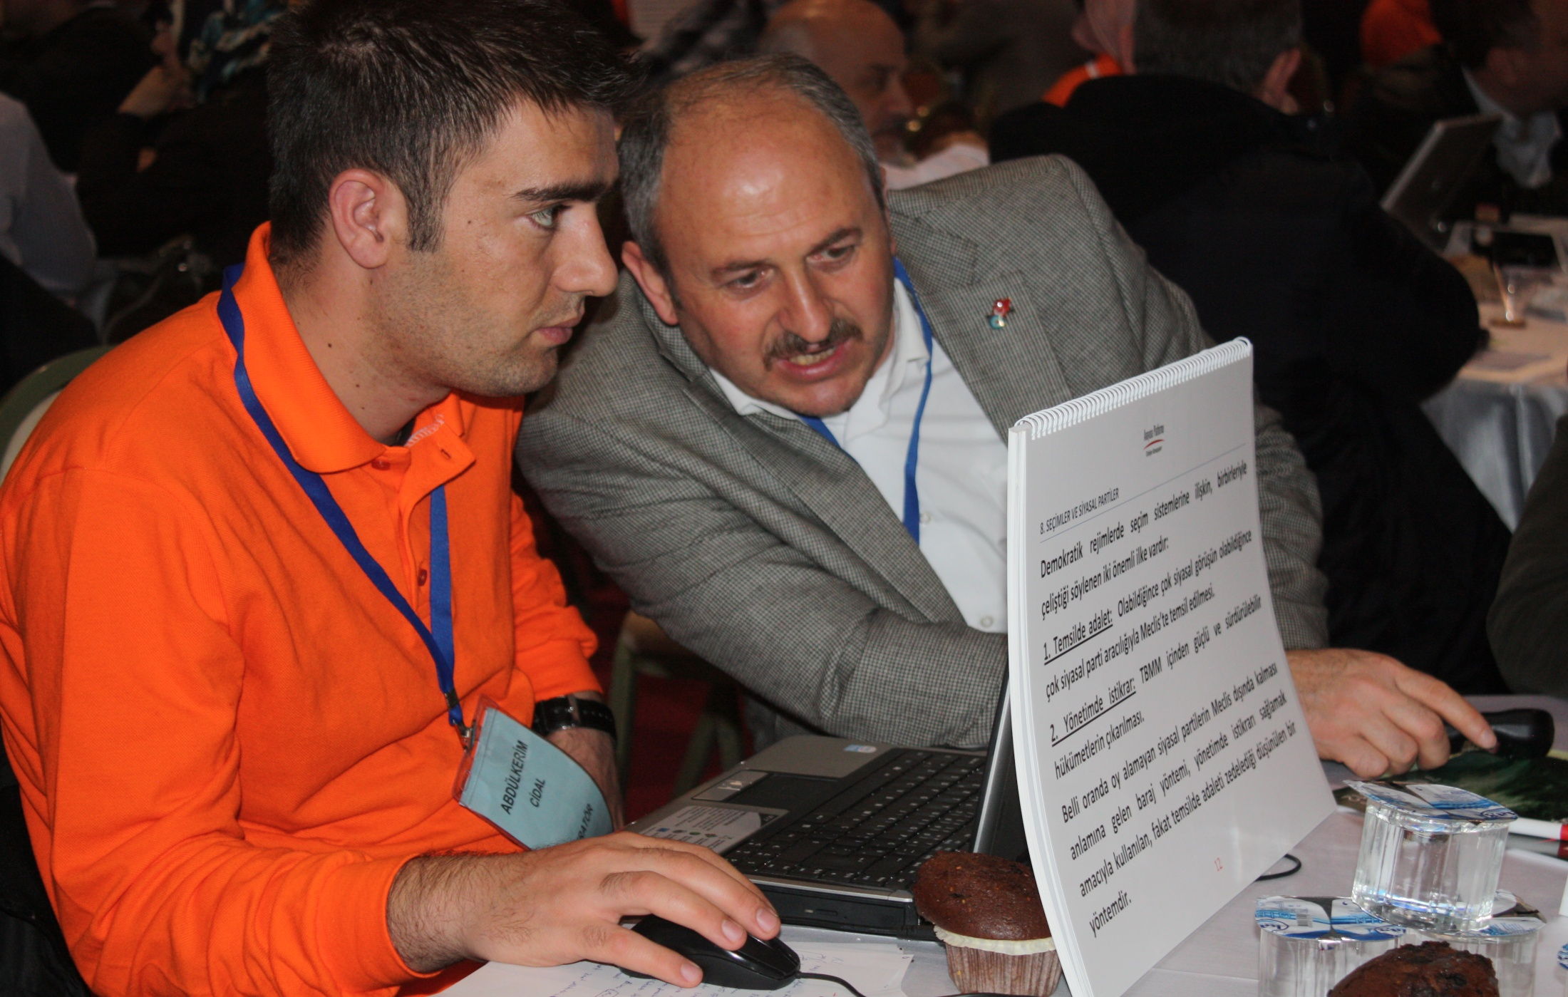
“Mark my words, son…”

Slide 44
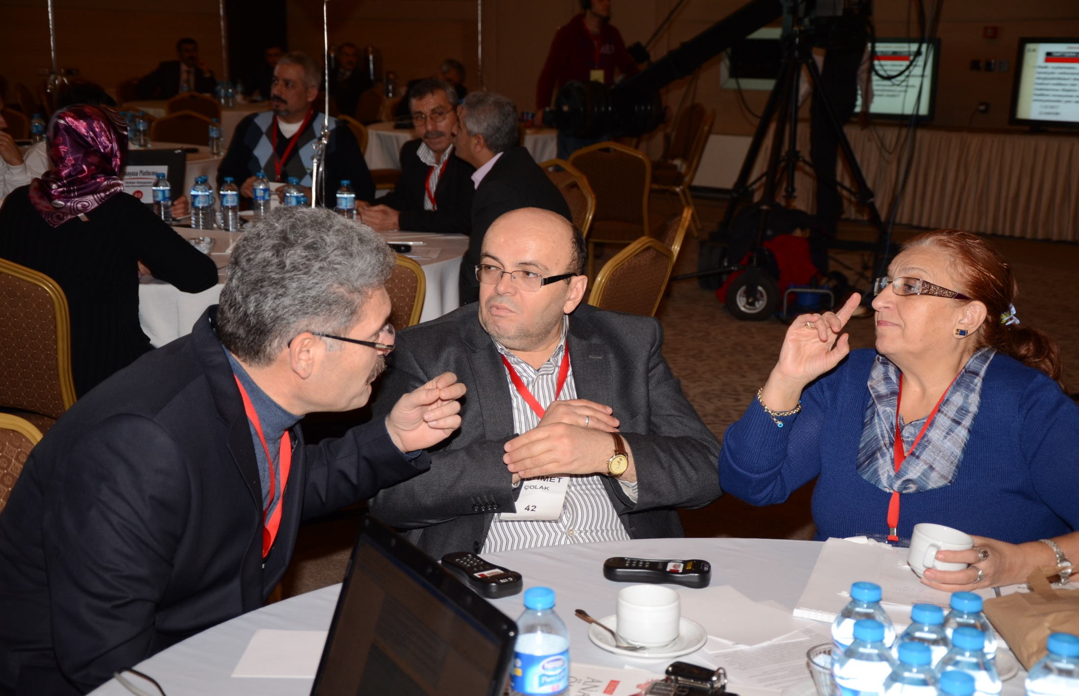
“That’s not the case, sir…”

Slide 45
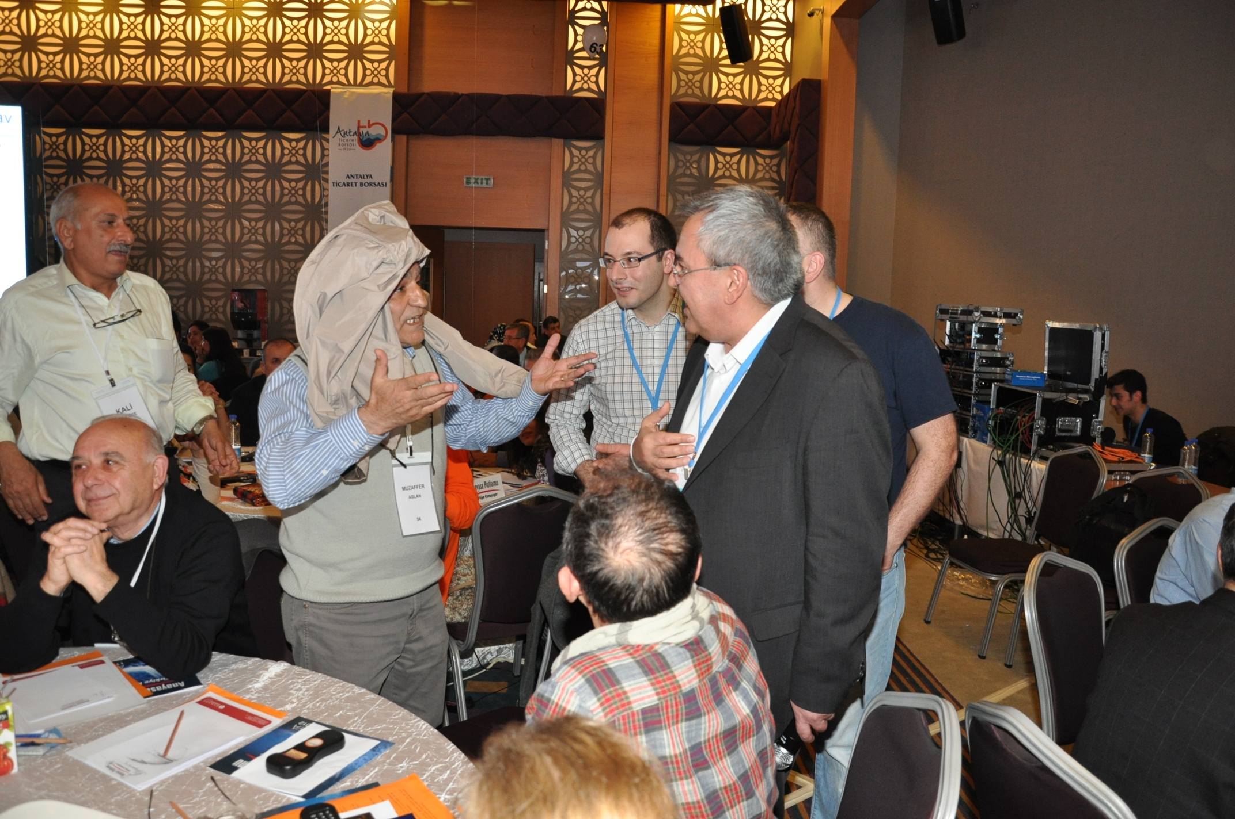
Some lost their temper, but none lost control

Slide 46
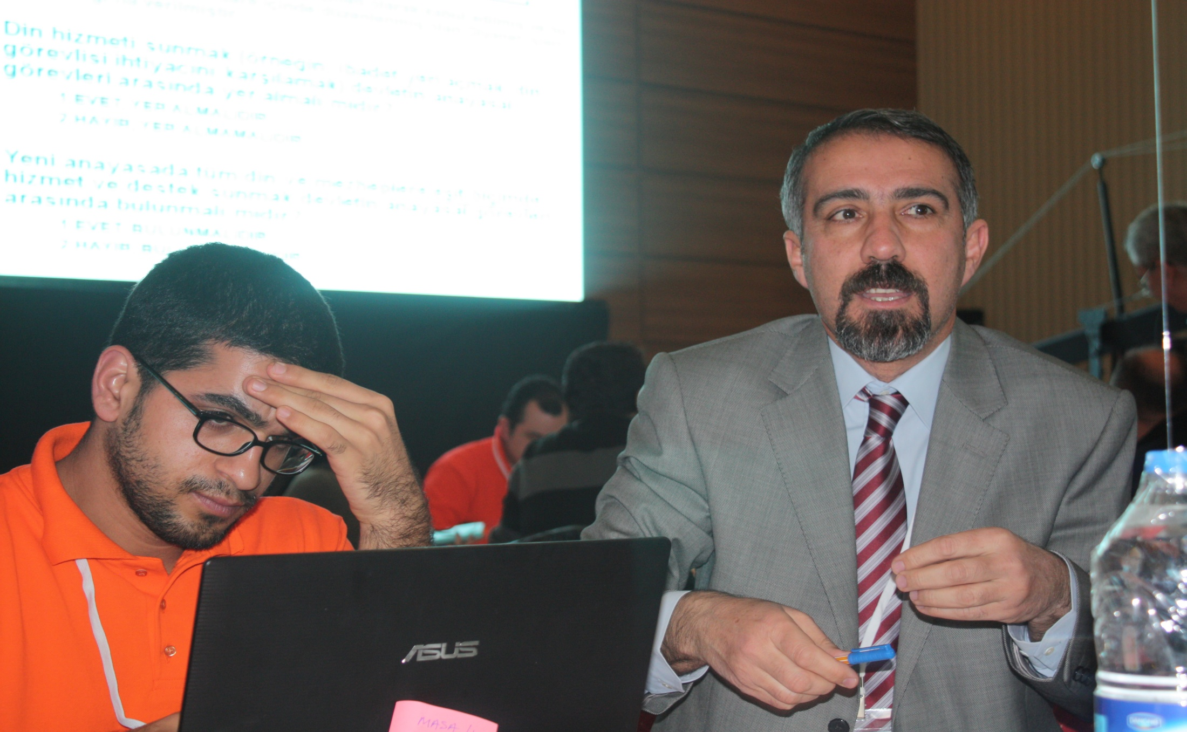
A discussion coordinator under pressure

Slide 47

After 10 hours of debate

Slide 48

Speaker of Parliament Cemil Çiçek receiving CP reports

Slide 49
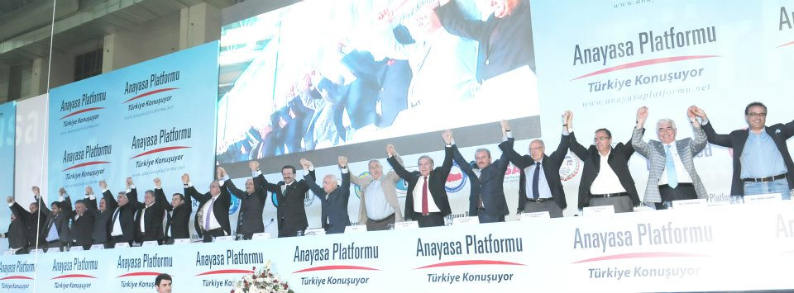
A strong demand for a new constitution

Slide 50
Conclusion
CP experience means debating contentious topics within a framework based on common sense.
  Insights into the question of which topics encourage a consensual constitution making process
Close cooperation with the Conciliation Commission
  By attending the Citizen Assemblies, commission members not only motivated participants, but got motivated themselves.
    Currently, they are writing a draft constitution, utilizing, among other contributions, citizens’ demands expressed through CP
Before the Citizen Assemblies, constitution making was a “very difficult” process.
  Now it is just “difficult”…

